Slide 1
Metric and Data Normalization
Yong Peng
2021/04/27

Slide 2
Objective
Basic objectives
Understand and master the basic knowledge on metric
Know some widely used metrics
Master and apply some widely used feature normalization methods
Advanced objectives
Reading materials to distance metric learning
Apply related knowledge into real applications

Slide 3
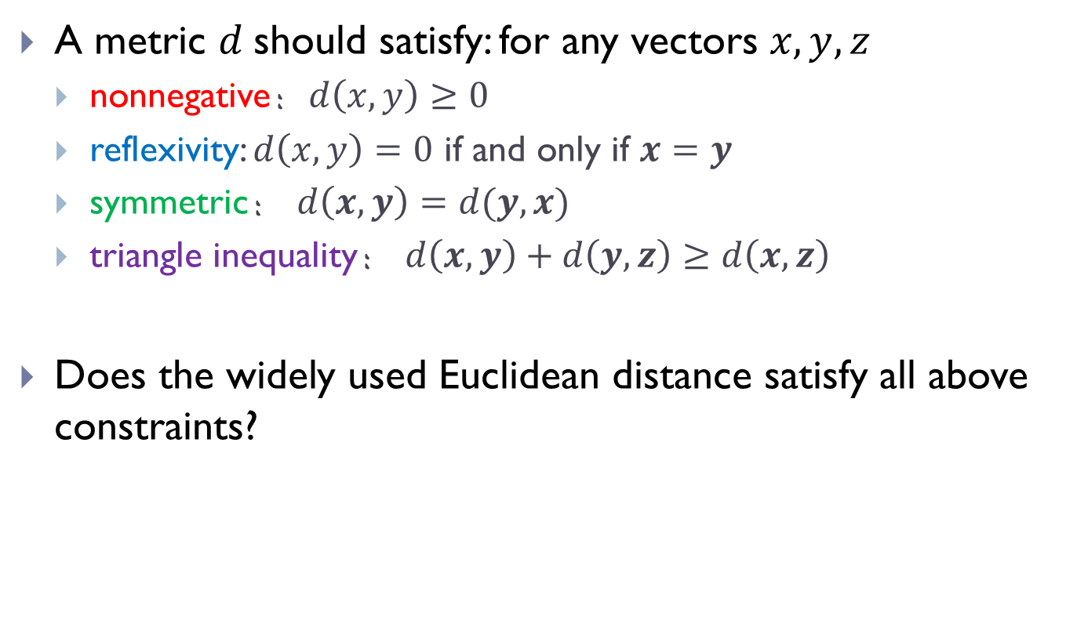
Metric
A metric $d$should satisfy: for any vectors $x,y,z$
nonnegative：$d\left(x,y\right)≥0$
reflexivity: $d\left(x,y\right)=0$ if and only if $x=y$
symmetric： $d\left(x,y\right)=d(y,x)$
triangle inequality： $d\left(x,y\right)+d\left(y,z\right)≥d\left(x,z\right)$
Does the widely used Euclidean distance satisfy all above constraints?

Slide 4
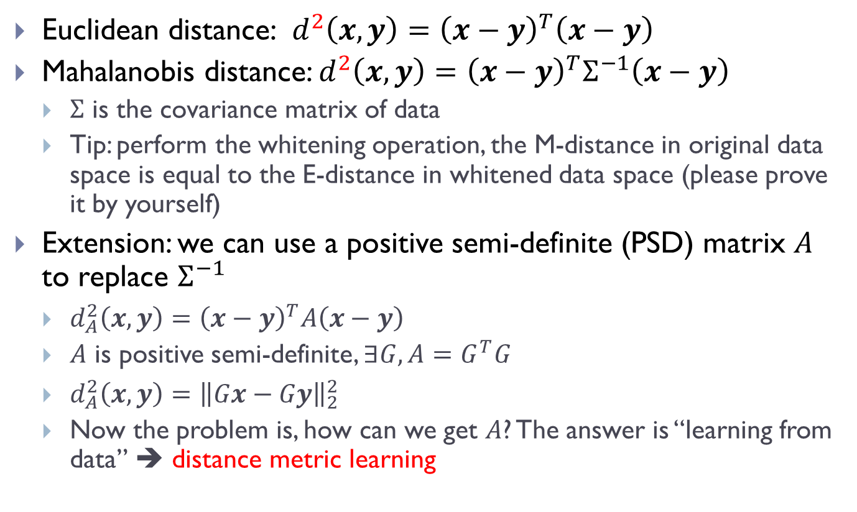
From Euclidean distance to Metric learning
Euclidean distance: $d^{2}\left(x,y\right)={\left(x−y\right)}^{T}\left(x−y\right)$
Mahalanobis distance: $d^{2}\left(x,y\right)={\left(x−y\right)}^{T}Σ^{−1}\left(x−y\right)$
$Σ$ is the covariance matrix of data
Tip: perform the whitening operation, the M-distance in original data space is equal to the E-distance in whitened data space (please prove it by yourself)
Extension: we can use a positive semi-definite (PSD) matrix $A$ to replace $Σ^{−1}$
$d_{A}^{2}\left(x,y\right)={\left(x−y\right)}^{T}A\left(x−y\right)$
$A$ is positive semi-definite, $∃G, A=G^{T}G$
$d_{A}^{2}\left(x,y\right)={\left\|Gx−Gy\right\|}_{2}^{2}$
Now the problem is, how can we get $A$? The answer is “learning from data” ➔ distance metric learning

Slide 5


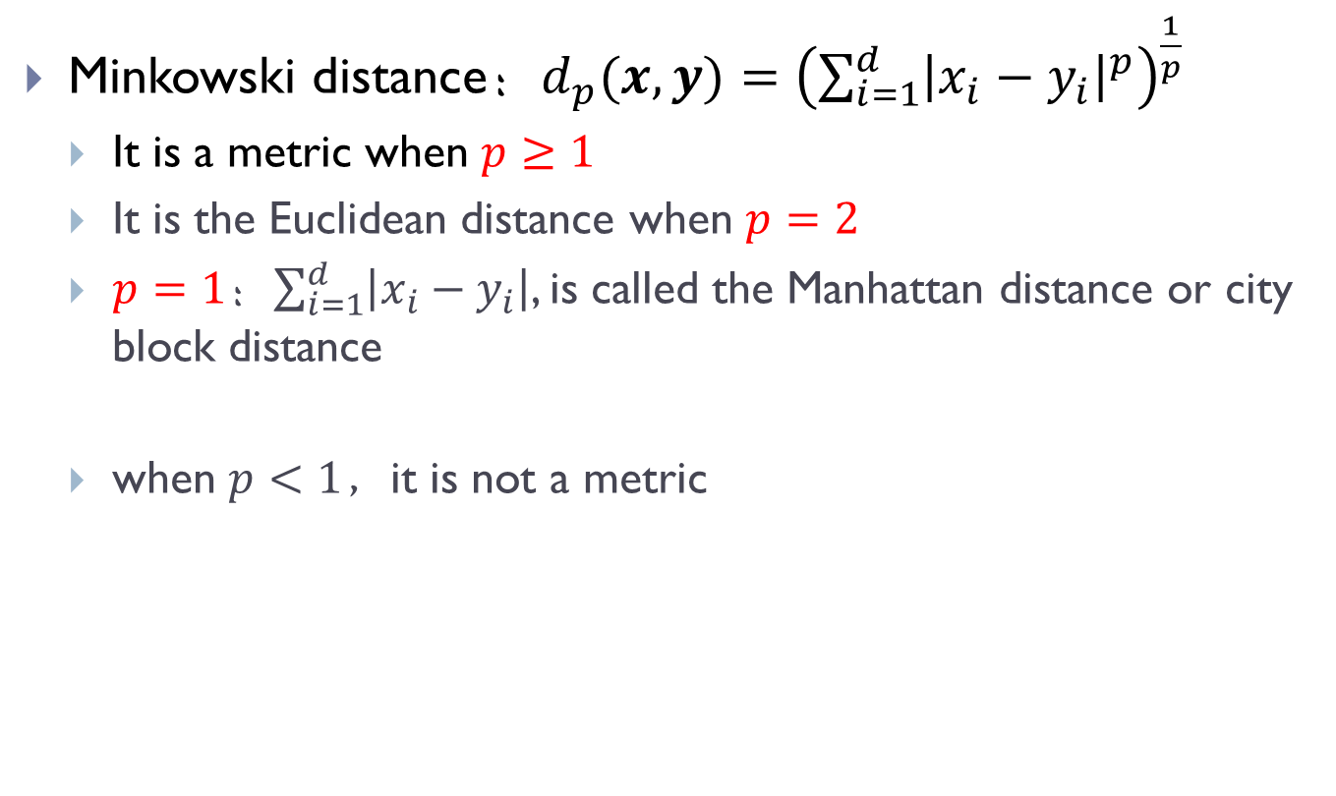




Distance in fixed forms
Minkowski distance：$d_{p}(x,y)={\left(\sum_{i=1}^{d}{{\left|x_{i}−y_{i}\right|}^{p}}\right)}^{\frac{1}{p}}$
It is a metric when $p≥1$
It is the Euclidean distance when $p=2$
$p=1$：$\sum_{i=1}^{d}{\left|x_{i}−y_{i}\right|}$, is called the Manhattan distance or city block distance
when $p<1$，it is not a metric
$$p=0.25$$
$$p=0.5$$
$$p=1$$
$$p=2$$
$$p=4$$
$$p=8$$

Slide 6
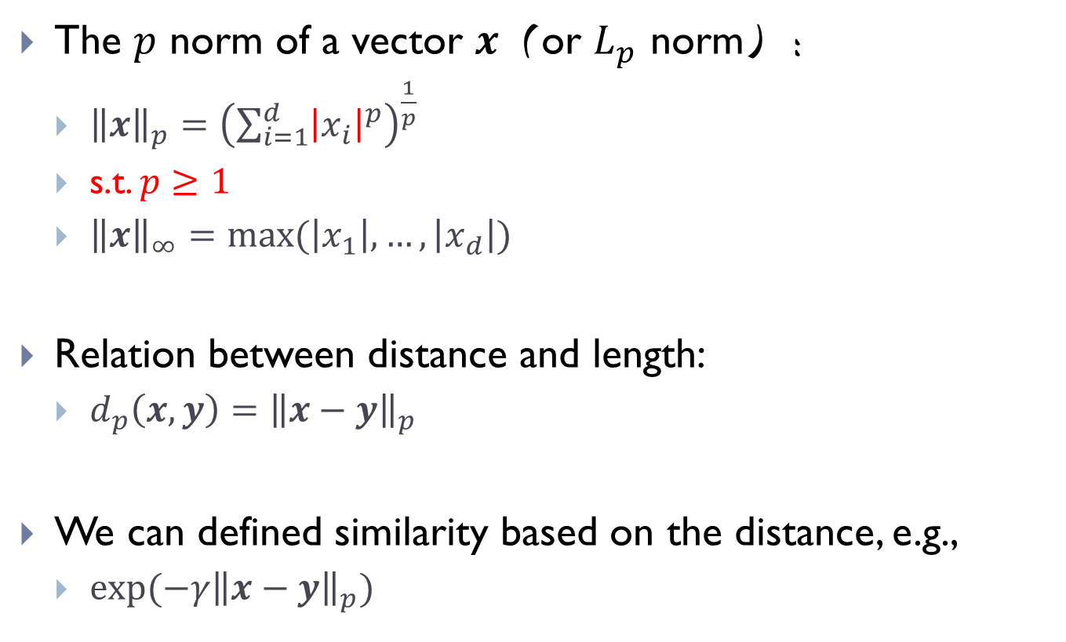
Norm、distance、similarity
The $p$ norm of a vector $x$（or $L_{p}$ norm）：
${\left\|x\right\|}_{p}={\left(\sum_{i=1}^{d}{{\left|x_{i}\right|}^{p}}\right)}^{\frac{1}{p}}$
s.t. $p≥1$
${\left\|x\right\|}_{∞}=max⁡(\left|x_{1}\right|,…,\left|x_{d}\right|)$
Relation between distance and length:
$d_{p}\left(x,y\right)={\left\|x−y\right\|}_{p}$
We can defined similarity based on the distance, e.g.,
$exp(−γ{\left\|x−y\right\|}_{p})$

Slide 7
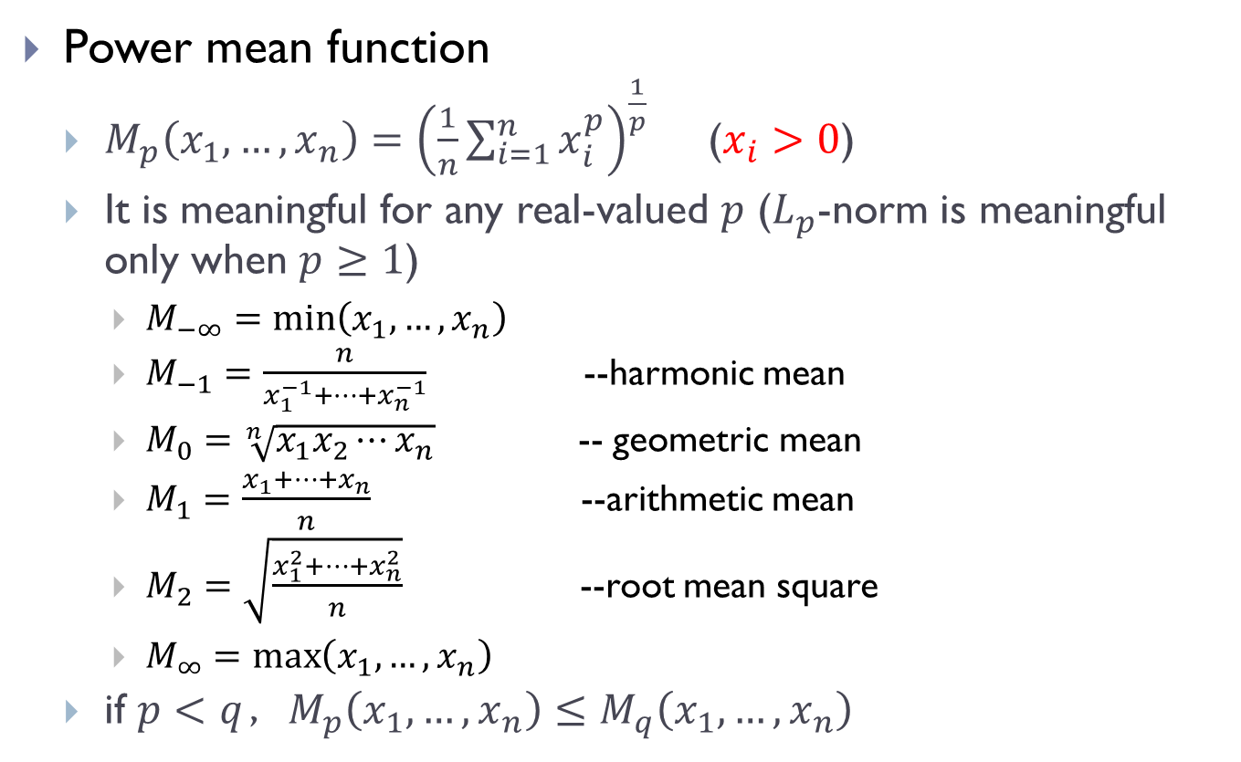
power mean function
Power mean function
$M_{p}\left(x_{1},…,x_{n}\right)={\left(\frac{1}{n}\sum_{i=1}^{n}{x_{i}^{p}}\right)}^{\frac{1}{p}}$ ($x_{i}>0$)
It is meaningful for any real-valued $p$ ($L_{p}$-norm is meaningful only when $p≥1$)
$M_{−∞}=\min\left(x_{1},…,x_{n}\right)$
$M_{−1}=\frac{n}{x_{1}^{−1}+⋯+x_{n}^{−1}}$ --harmonic mean
$M_{0}=\sqrt[n]{x_{1}x_{2}⋯x_{n}}$ -- geometric mean
$M_{1}=\frac{x_{1}+⋯+x_{n}}{n}$ --arithmetic mean
$M_{2}=\sqrt{\frac{x_{1}^{2}+⋯+x_{n}^{2}}{n}}$ --root mean square
$M_{∞}=\max\left(x_{1},…,x_{n}\right)$
if $p<q$，$M_{p}\left(x_{1},…,x_{n}\right)≤M_{q}\left(x_{1},…,x_{n}\right)$

Slide 8



Power mean function
Considering two real values, $a$ and $b$, $M_{p}\left(a,b\right)$ can be seen as the similarity between them.
F

Slide 9
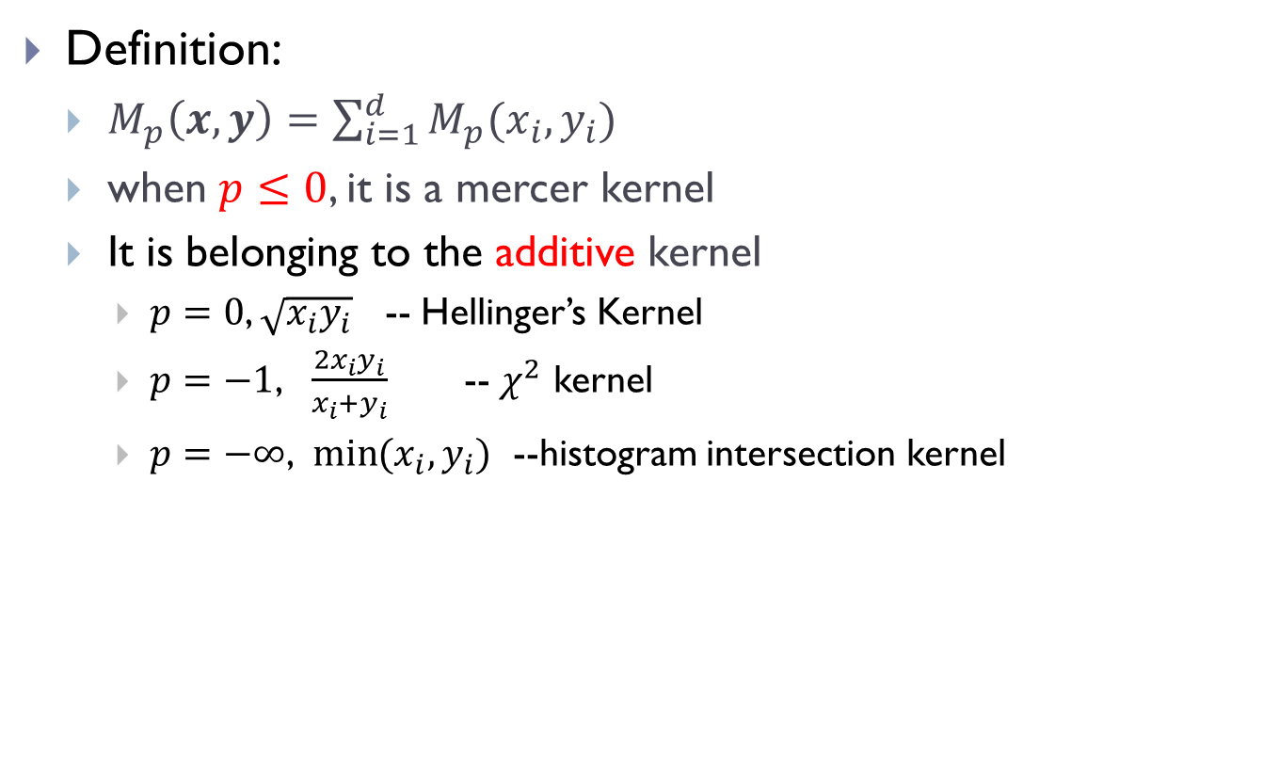
Power mean kernel
Definition:
$M_{p}\left(x,y\right)=\sum_{i=1}^{d}{M_{p}(x_{i},y_{i})}$
when $p≤0$, it is a mercer kernel
It is belonging to the additive kernel
$p=0$, $\sqrt{x_{i}y_{i}}$ -- Hellinger’s Kernel
$p=−1$, $\frac{2x_{i}y_{i}}{x_{i}+y_{i}}$ -- $χ^{2}$ kernel
$p=−∞$, $\min{(x_{i},y_{i})}$ --histogram intersection kernel

Slide 10
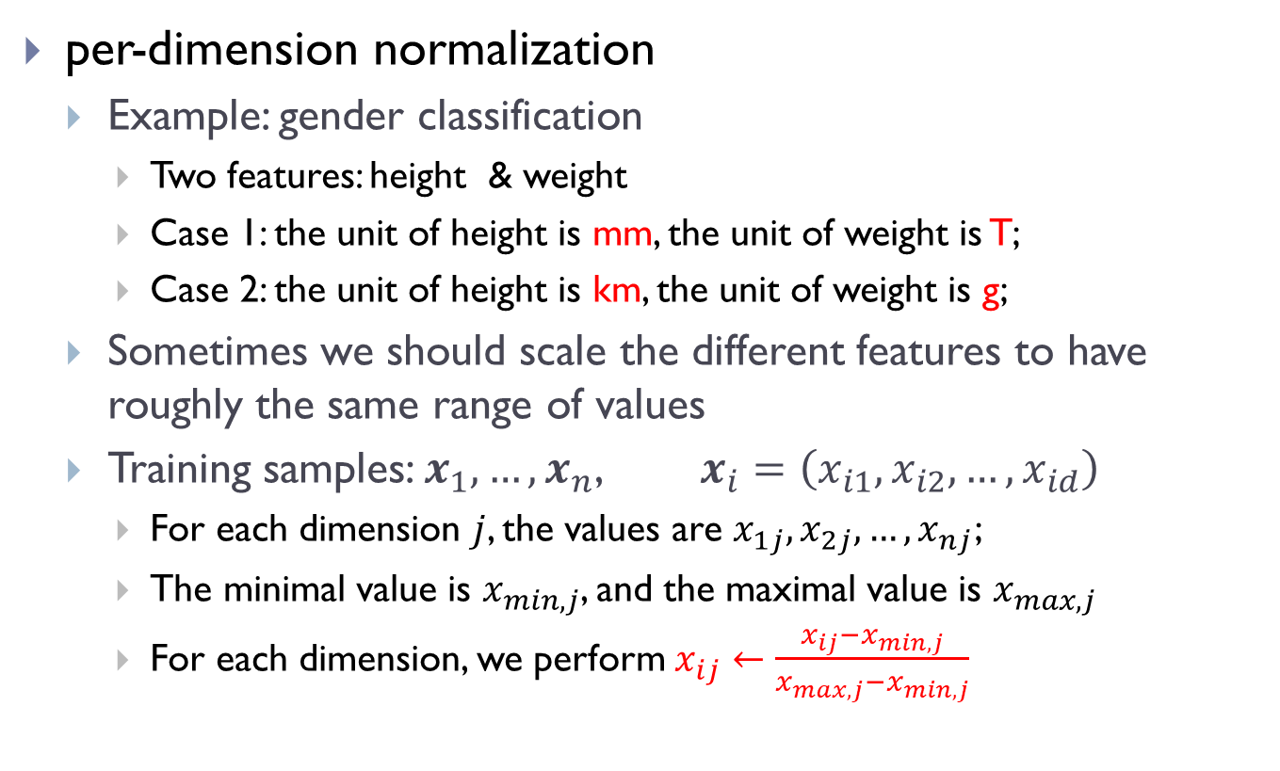
Normalization
per-dimension normalization
Example: gender classification
Two features: height & weight
Case 1: the unit of height is mm, the unit of weight is T;
Case 2: the unit of height is km, the unit of weight is g;
Sometimes we should scale the different features to have roughly the same range of values
Training samples: $x_{1},…,x_{n}$, $x_{i}=\left(x_{i1},x_{i2},…,x_{id}\right)$
For each dimension $j$, the values are $x_{1j},x_{2j},…,x_{nj}$;
The minimal value is $x_{min,j}$, and the maximal value is $x_{max,j}$
For each dimension, we perform $x_{ij}←\frac{x_{ij}−x_{min,j}}{x_{max,j}−x_{min,j}}$

Slide 11

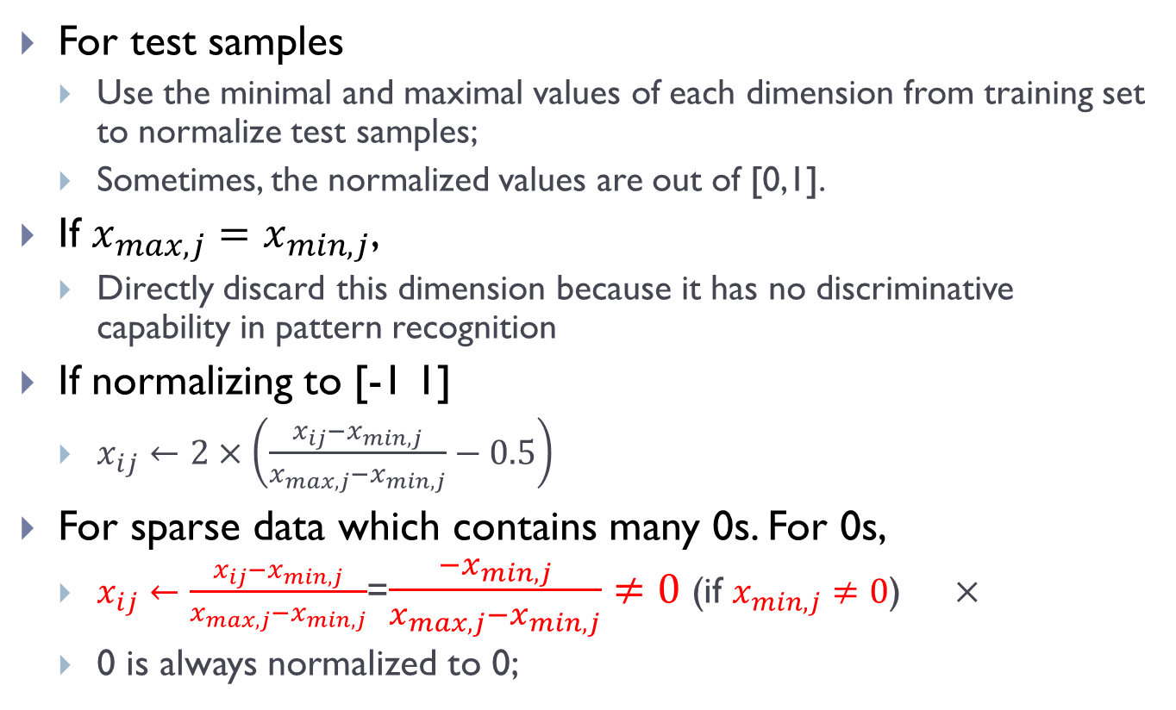

per-dimension normalization
For test samples
Use the minimal and maximal values of each dimension from training set to normalize test samples;
Sometimes, the normalized values are out of [0,1].
If $x_{max,j}=x_{min,j}$,
Directly discard this dimension because it has no discriminative capability in pattern recognition
If normalizing to [-1 1]
$x_{ij}←2×\left(\frac{x_{ij}−x_{min,j}}{x_{max,j}−x_{min,j}}−0.5\right)$
For sparse data which contains many 0s. For 0s,
$x_{ij}←\frac{x_{ij}−x_{min,j}}{x_{max,j}−x_{min,j}}$=$\frac{−x_{min,j}}{x_{max,j}−x_{min,j}}≠0$ (if $x_{min,j}≠0$) $×$
0 is always normalized to 0;

Slide 12

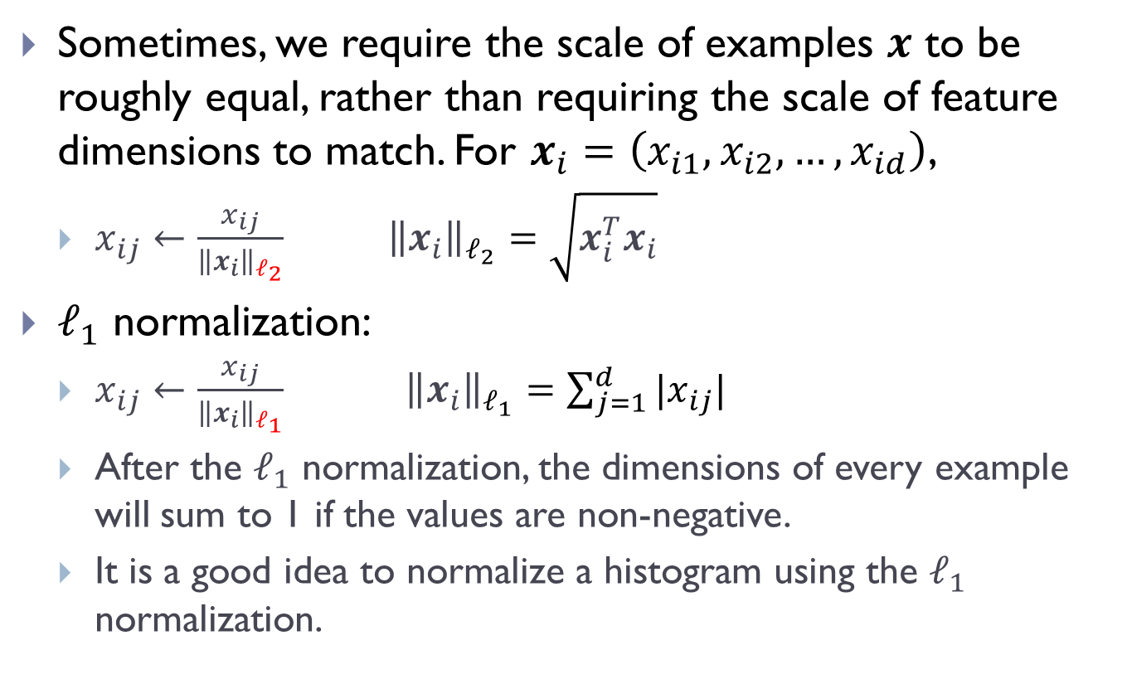

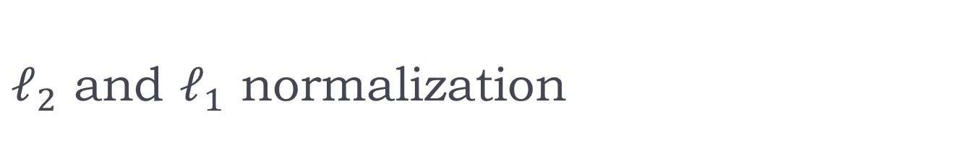

$ℓ_{2}$ and $ℓ_{1}$ normalization
Sometimes, we require the scale of examples $x$ to be roughly equal, rather than requiring the scale of feature dimensions to match. For $x_{i}=\left(x_{i1},x_{i2},…,x_{id}\right)$,
$x_{ij}←\frac{x_{ij}}{{\left\|x_{i}\right\|}_{ℓ_{2}}} {\left\|x_{i}\right\|}_{ℓ_{2}}=\sqrt{x_{i}^{T}x_{i}}$
$ℓ_{1}$ normalization:
$x_{ij}←\frac{x_{ij}}{{\left\|x_{i}\right\|}_{ℓ_{1}}} {\left\|x_{i}\right\|}_{ℓ_{1}}=\sum_{j=1}^{d}{|x_{ij}|}$
After the $ℓ_{1}$ normalization, the dimensions of every example will sum to 1 if the values are non-negative.
It is a good idea to normalize a histogram using the $ℓ_{1}$ normalization.

Slide 13
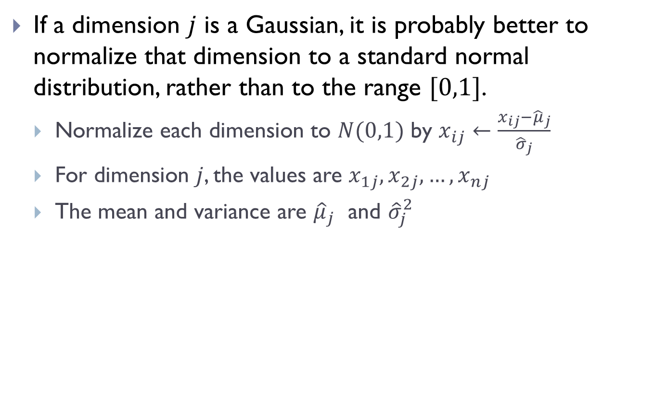
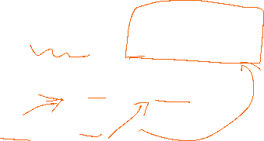
zero-norm, unit variance
If a dimension $j$ is a Gaussian, it is probably better to normalize that dimension to a standard normal distribution, rather than to the range $[0,1]$.
Normalize each dimension to $N(0,1)$ by $x_{ij}←\frac{x_{ij}−{\hat{μ}}_{j}}{{\hat{σ}}_{j}}$
For dimension $j$, the values are $x_{1j},x_{2j},…,x_{nj}$
The mean and variance are ${\hat{μ}}_{j}$ and ${\hat{σ}}_{j}^{2}$

